Slide 1
Capstone Orientation for DS & AI Course

Slide 2
Agenda
How to Select Capstone Project
How to Execute Project
Modelling and Evaluation
Project Submission Requirements
Capstone Example

Slide 3
Introduction

Slide 4
Introduction
Importance of Project Selection:
Alignment: Choosing the right project aligns with your career goals and enhances learning.
Impact: It allows you to apply knowledge effectively and make a meaningful contribution.
Overview of Session Content:
Project Selection: Navigate the LMS to choose a project relevant to your course/domain.
Executing Your Project: Steps from problem understanding to model evaluation.
Project Submission: Requirements for Python code (Jupyter notebook), project report (PPT), and optional dashboard.

Slide 5
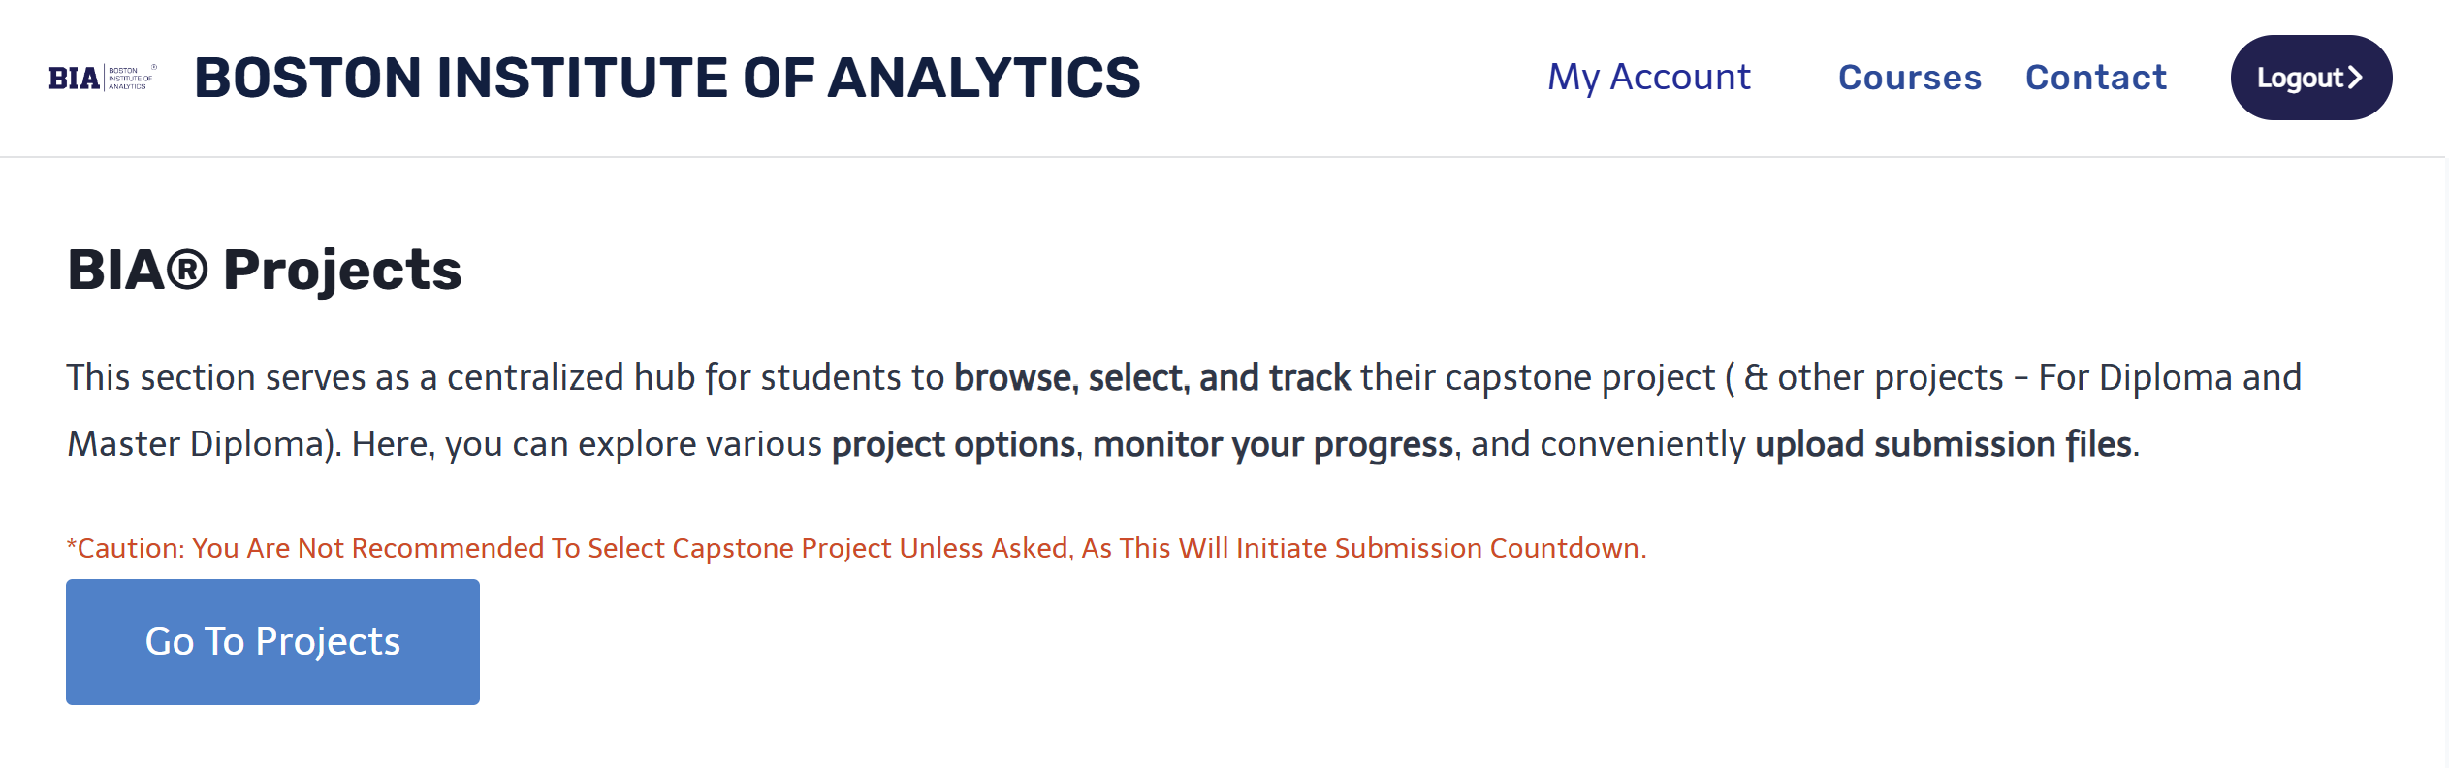
Selecting Your Project
1. Login to the LMS
2. Navigate to "My Account“
3. Click on "Go to Project" option
4. Select Course, and Select Project from

Slide 6
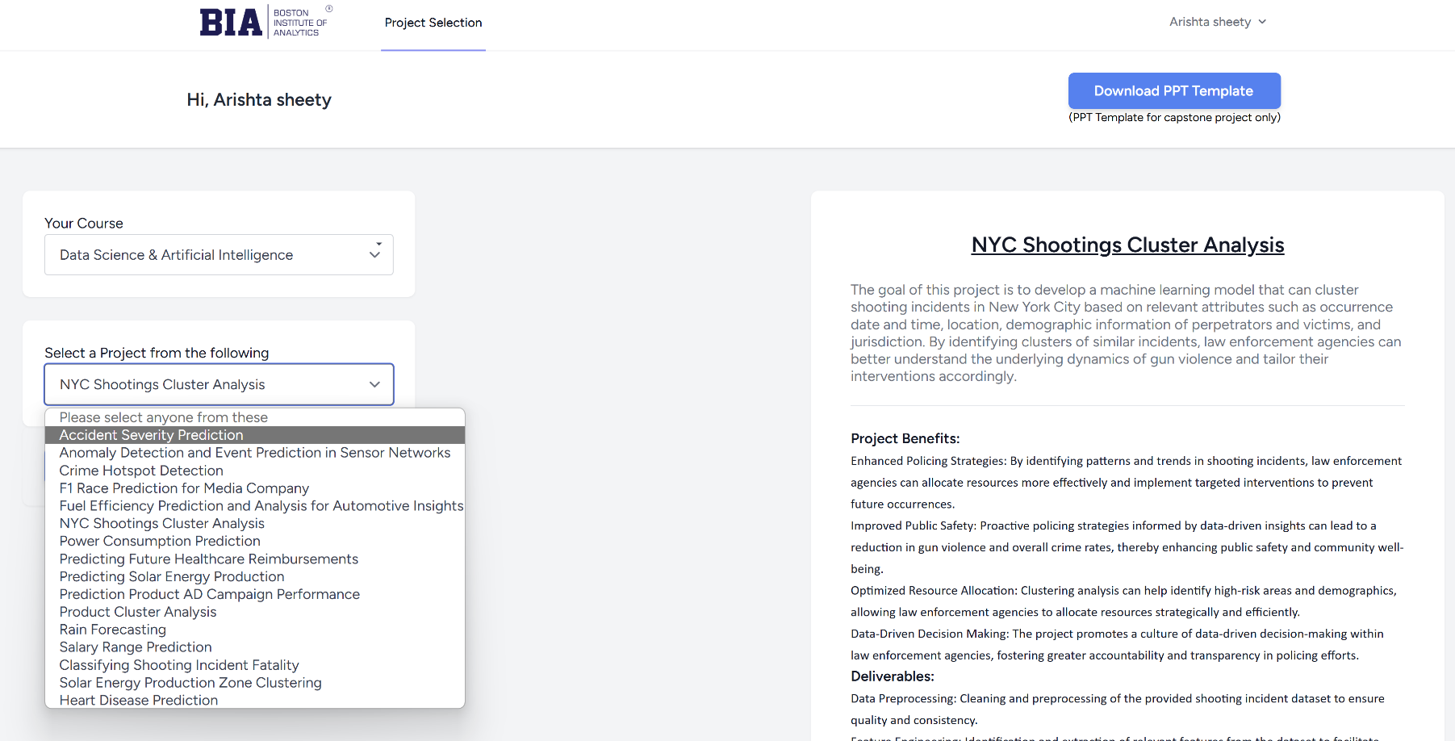
Choosing Your Project
Select the relevant Course/Domain
Review available projects
Choose a project that aligns with your interests and goals
Deadline for the Project is 13 days from the Date of Project Selection.

Slide 7
Project Components

Slide 8
Understanding the Problem Statement
Carefully Read the Problem Statement:
Read through the problem statement thoroughly to grasp its scope and details.
Identify the Key Objectives and Requirements:
Determine the primary goals and specific requirements outlined in the problem statement.
Ask Clarifying Questions if Needed:
If any aspects of the problem statement are unclear, ask questions to clarify ambiguities and ensure a thorough understanding.

Slide 9
Preprocessing the Provided Dataset
1. Understand the Dataset:
Familiarize yourself with the structure, variables, and any accompanying documentation.
2. Data Cleaning:
Handle Missing Values: Identify and address any missing data points appropriately (e.g., imputation, removal).
Remove Outliers: Identify and remove outliers that could skew analysis or modelling results.
3. Data Transformation:
Normalization: Scale numerical features to a standard range if needed.
Encoding: Convert categorical variables into numerical representations suitable for modeling.
4. Feature Engineering:
Create New Features: Derive new features from existing ones that might improve model performance.
Feature Selection: Select the most relevant features based on their importance for the problem at hand.

Slide 10

Exploratory Data Analysis (EDA) and Model Selection
Perform Exploratory Data Analysis (EDA):
Summary Statistics: Calculate descriptive statistics (mean, median, etc.) to understand data distributions.
Data Visualization: Plot histograms, box plots, scatter plots, etc., to visualize data patterns and relationships.
Correlation Analysis: Explore correlations between variables to identify potential dependencies.

Slide 11

Cont…
Visualize Data Patterns and Relationships:
Univariate Analysis: Visualize distributions of individual variables to understand their spread and skewness.
Bivariate Analysis: Explore relationships between pairs of variables using scatter plots or correlation matrices.
Multivariate Analysis: Visualize interactions between multiple variables using techniques like pair plots or heatmaps.

Slide 12

Cont…
Select Appropriate Models:
Problem Understanding: Based on EDA insights, clarify the problem type (e.g., regression, classification, clustering).
Data Characteristics: Consider the data's volume, dimensionality, and nature (e.g., structured, unstructured).
Model Suitability: Choose models that are appropriate for the problem type and data characteristics (e.g., linear regression, decision trees, neural networks).

Slide 13

Model Training, Validation, and Evaluation
Split Data into Training and Testing Sets:
Training Set: Use a portion of the data (typically 70-80%) to train your model.
Testing Set: Reserve the remaining data (20-30%) for testing and evaluating model performance.
Train Models and Validate Performance:
Model Training: Use the training set to train your selected models.
Validation Techniques: Apply cross-validation techniques to tune model parameters and prevent overfitting.
K-Fold Cross-Validation: Divide data into K subsets and train the model K times, each time using a different subset as the validation set.

Slide 14
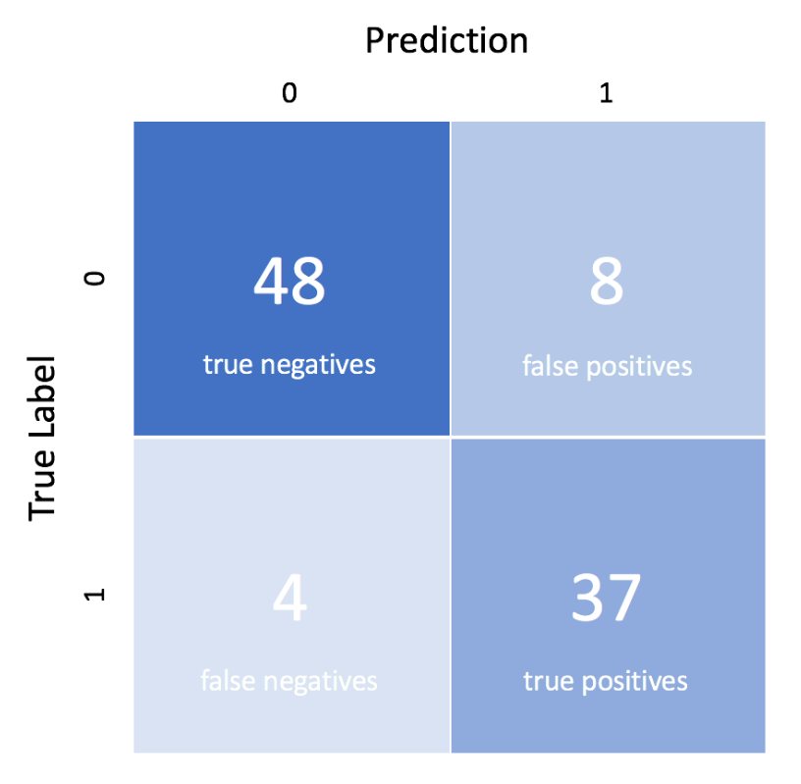
Cont…
Evaluate Models Using Appropriate Metrics:
Accuracy: The proportion of correctly predicted instances out of the total instances.
Precision: The ratio of correctly predicted positive observations to the total predicted positives.
Recall (Sensitivity): The ratio of correctly predicted positive observations to all observations in the actual class.
F1 Score: The weighted average of Precision and Recall, useful when the class distribution is imbalanced.
Other Metrics: Depending on the problem, other metrics like AUC-ROC for classification or RMSE for regression might be used.

Slide 15
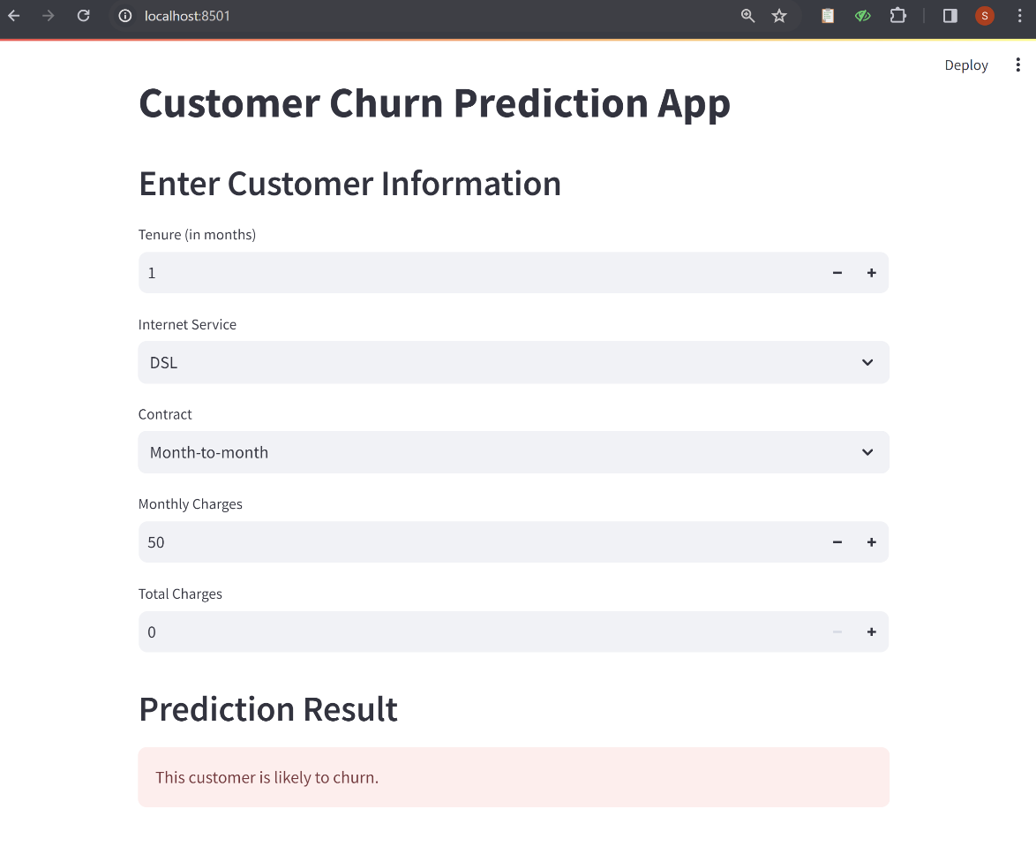
Model Deployment Using Streamlit
What is Streamlit?
An open-source Python library for creating and sharing data applications.
Simplifies turning data scripts into interactive web apps.
Optional Step for Capstone Projects:
Deploy Your Project: You can deploy your capstone project using Streamlit.
Optional Step: This is an optional step, but it is encouraged.
Benefits: Enhances the presentation and accessibility of your project, providing a professional and interactive showcase.

Slide 16
Project Submission

Slide 17
Project Deliverables
Python Code (Jupyter Notebook):
Include code for data preprocessing, EDA, modelling, and evaluation.
Ensure the code is well-documented and reproducible.
Project Report (PPT):
Introduction: Problem statement, objectives, and data description.
Methodology: Steps for data preprocessing, EDA, modeling, and evaluation.
Results: Key findings and model performance.
Conclusion: Summary, implications, and future work.
PowerBI/Tableau Dashboard (Optional):
Create an interactive dashboard to visualize key insights and results.
Include charts, graphs, and tables highlighting important findings.

Slide 18
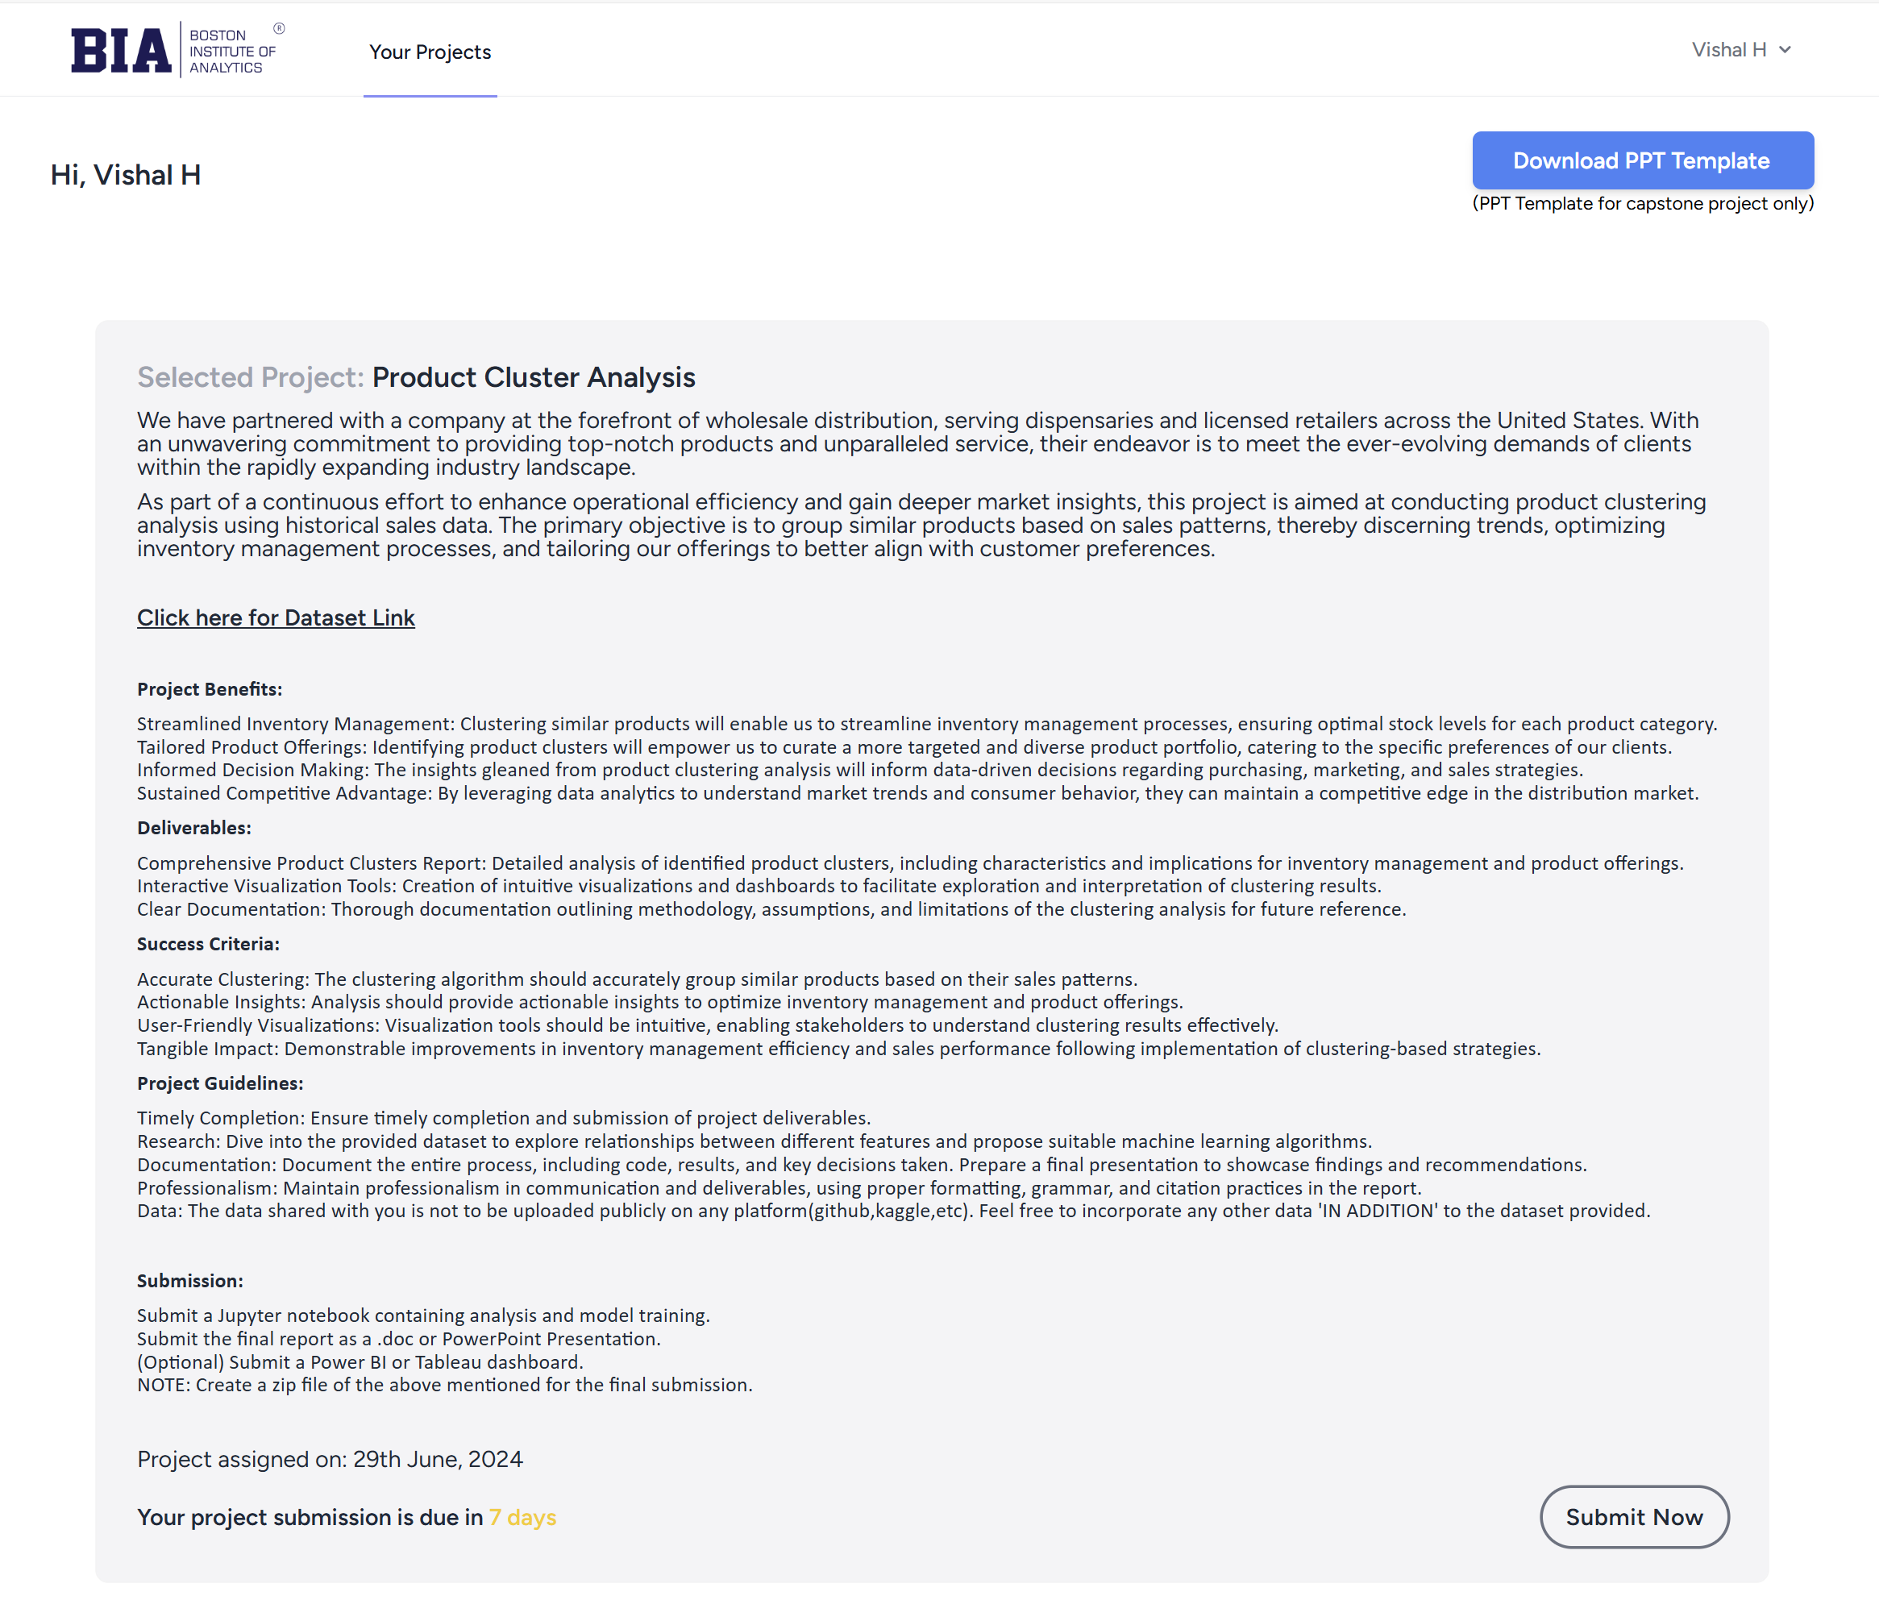
Project Submission
Login to the LMS
Navigate to "My Account“
Click on "Go to Project" option
Click on “Submit Now”
For final submission, upload the “ZIP file” containing all project files (Python Code, PPT, Dashboard (if any))

Slide 19
Project Example – Case Study

Slide 20
Project Example
Project Name: Heart Disease Prediction
Click Here for Link
Notes:
Trainer Must Explain this project to Students
Trainer Can share the link with Students

Slide 21
Questions ?

Slide 22
Thank You!

